Slide 1
Introduction to Server-side Development

Slide 2
Objectives
Understand the basics of Node.js
Download and install Node.js and NPM
Verify that the installation was successful and your machine is ready for using Node.js and NPM
Write a simple Node application in JavaScript
Understand the basics of Node modules and write simple file-based Node modules
Callback and Error handling in Node applications

Slide 3
Node.js and NPM

Slide 4
What is Node.js?
Node.js is an open source server environment
Node.js is free
Node.js runs on various platforms (Windows, Linux, Unix, Mac OS X, etc.)
Node.js uses JavaScript on the server
JavaScript runtime built on Chrome V8 JavaScript Engine

Slide 5
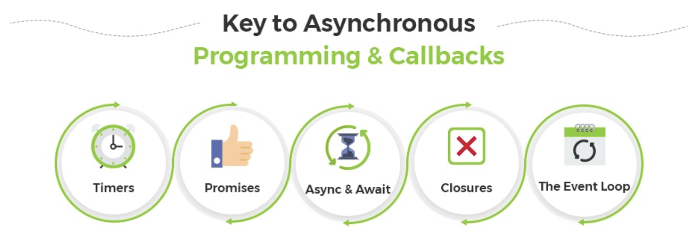
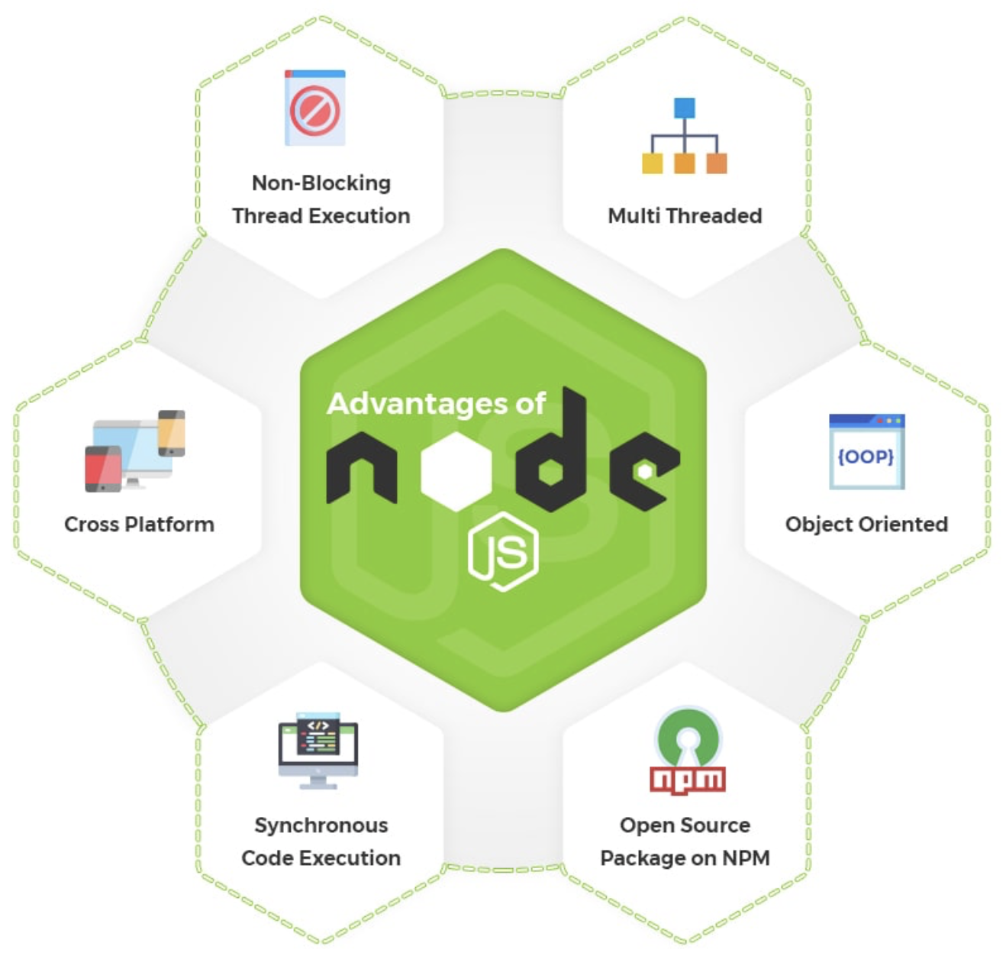
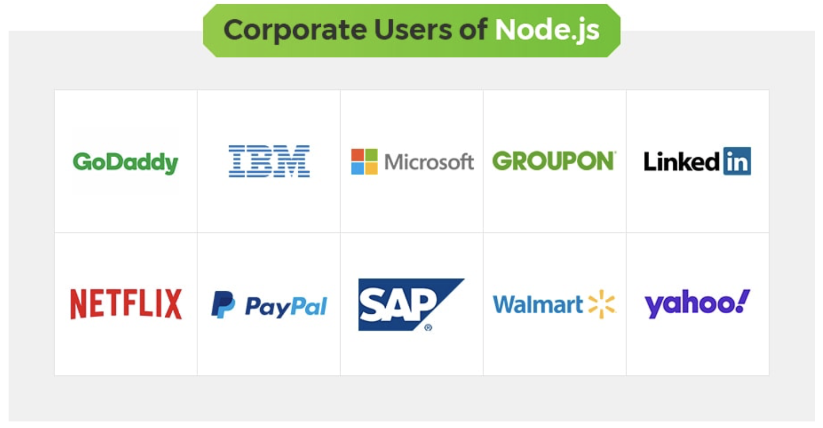
Why Node.js?

Slide 6
Why is Node.js
The traditional web server handles a file request | Node.js handles a file request
Sends the task to the computer's file system. Waits while the file system opens and reads the file. Returns the content to the client. Ready to handle the next request. | Sends the task to the computer's file system. Ready to handle the next request. When the file system has opened and read the file, the server returns the content to the client.
Node.js eliminates the waiting, and simply continues with the next request.
Node.js runs single-threaded, non-blocking, asynchronous programming, which is very memory efficient.

Slide 7
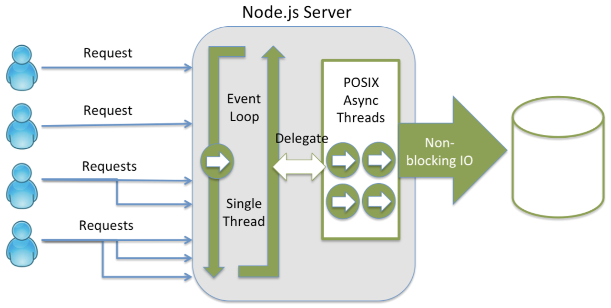
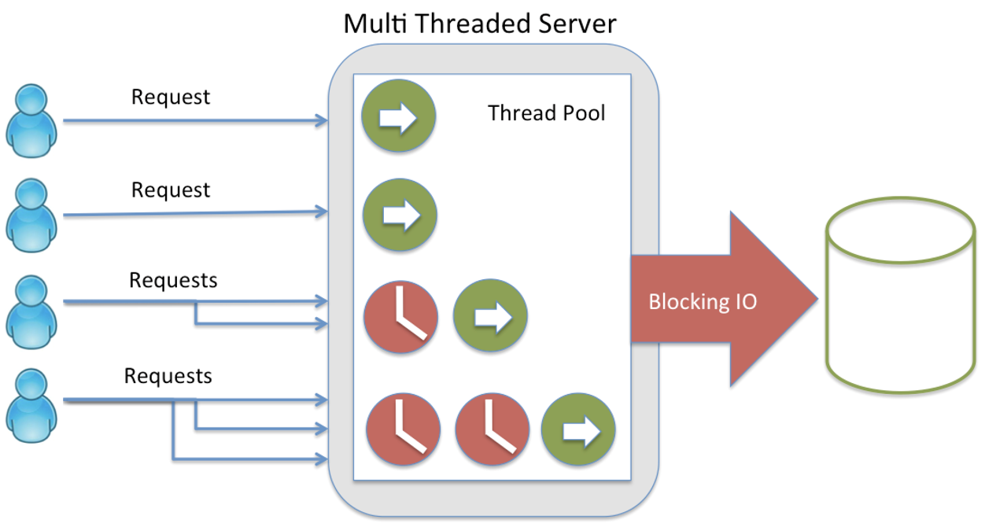
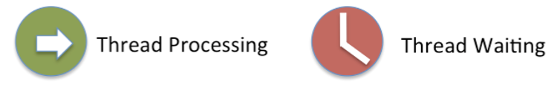
Why is Node.js

Slide 8
What can Node.js do?
Node.js can generate dynamic page content
Node.js can create, open, read, write, delete, and close files on the server
Node.js can collect form data
Node.js can add, delete, modify data in your database

Slide 9
What is a Node.js File?
Node.js files contain tasks that will be executed on certain events
A typical event is someone trying to access a port on the server
Node.js files must be initiated on the server before having any effect
Node.js files have extension “.js”

Slide 10
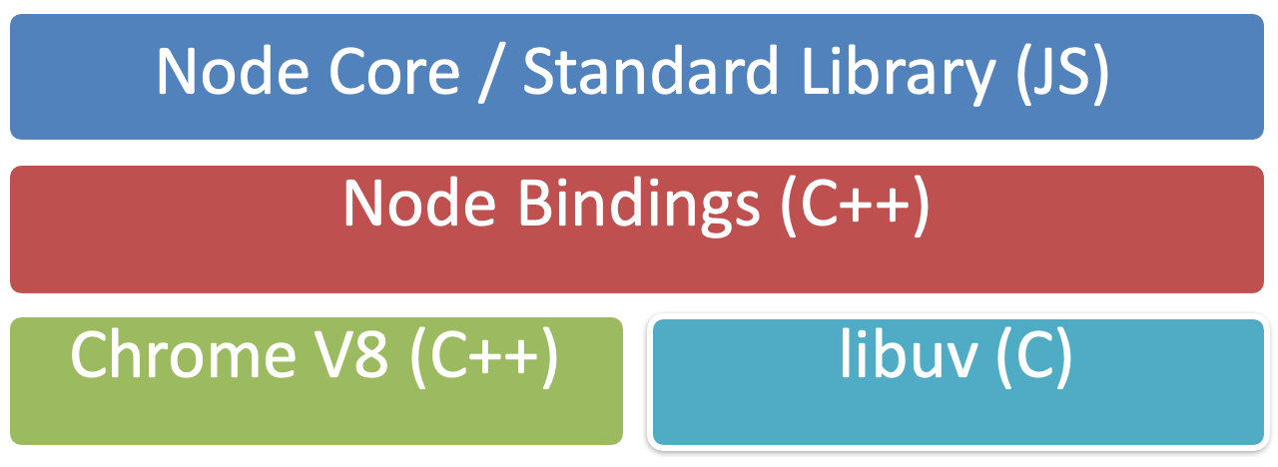
Node Architecture

Slide 11
Node.js Use Cases
Utilities written in JavaScript for web development:
Bower, Grunt, Gulp, Yeoman etc.
Server-side Development
Web server, Business logic, Database access

Slide 12
Node Package Manager (NPM)
Node package manager (NPM): manages ecosystem of node modules / packages
A package contains:
JS files
package.json (manifest)

Slide 13
package.json
A package.json file affords you a lot of great things:
It serves as documentation for what packages your project depends on.
It allows you to specify the versions of a package that your project can use using semantic versioning rules.
Makes your build reproducible, which means that its way easier to share with other developers.
Source: https://docs.npmjs.com/getting-started/using-a-package.json

Slide 14
Initializing package.json
To initialize a package.json file for your project, type at the prompt in your project directory:
npm init
Follow along and answer the prompts to initialize

Slide 15
Setting up Node.js and NPM

Slide 16
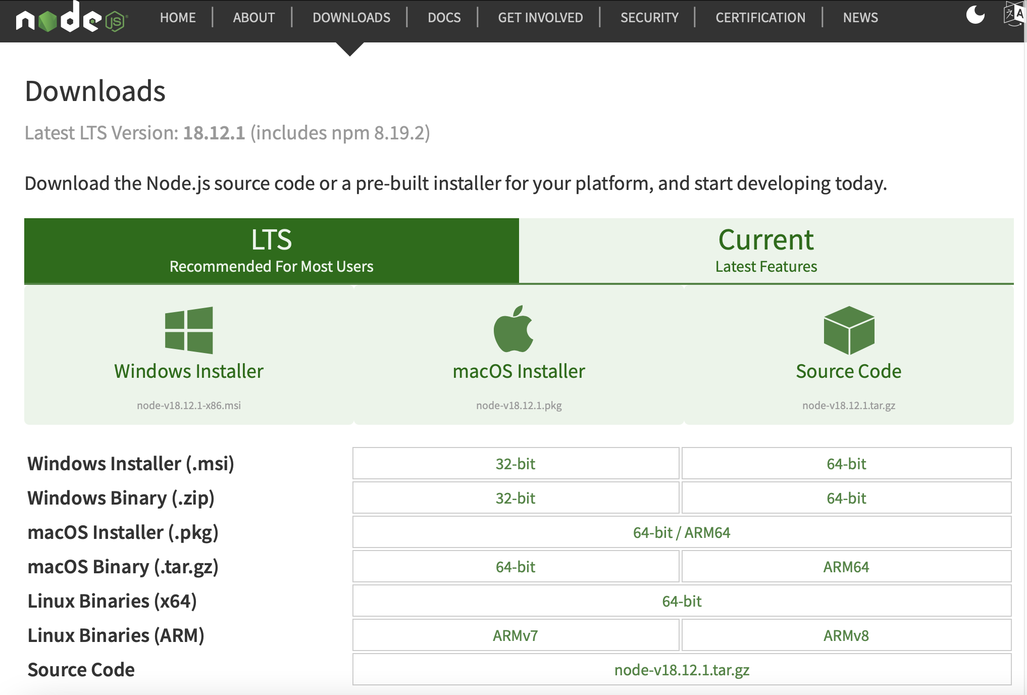
Installing Node
To install Node on your machine, go to https://nodejs.org and click on the Download button. Depending on your computer's platform (Windows, MacOS or Linux), the appropriate installation package is downloaded
Notes:
Or, use NVM (Node Version Management) to manage Node: install, uninstall, change node versions (https://www.linode.com/docs/guides/how-to-install-use-node-version-manager-nvm/)

Slide 17
Verifying the Node Installation
Open a terminal window on your machine. If you are using a Windows machine, open a cmd window or PowerShell window with admin privileges.
To ensure that your NodeJS setup is working correctly, type the following at the command prompt to check for the version of Node and NPM
node -v
npm -v

Slide 18
Write a simple Node application in JavaScript

Slide 19
Write a simple Node application in JavaScript
Go to a convenient location on your computer and create a folder named NodeJS. Then move to this folder.
Now create a folder named node-examples and then move into this folder.
At the prompt, type the following to initialize a package.json file in the node-examples folder:
npm init

Slide 20
Update the package.json file
Accept the standard defaults suggested and then update the package.json file until you end up with the file containing the following:
{
"name": "node-examples",
"version": "1.0.0",
"description": "Simple Node Examples",
"main": "index.js",
"scripts": {
"test": "echo \"Error: no test specified\" && exit 1",
"start": "node index"
},
"author": ”FPTU",
"license": "ISC"
}

Slide 21
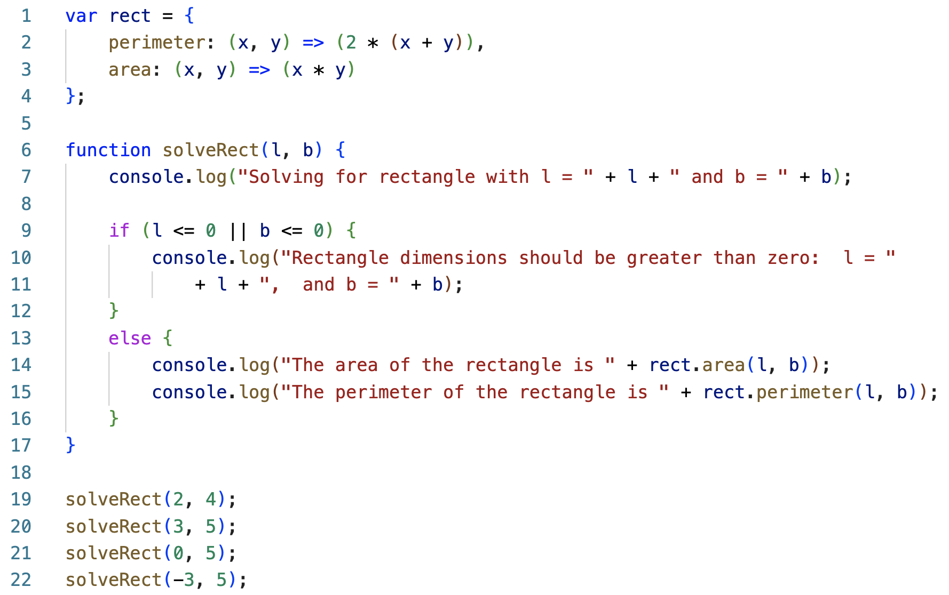
Create a file named index.js

Slide 22
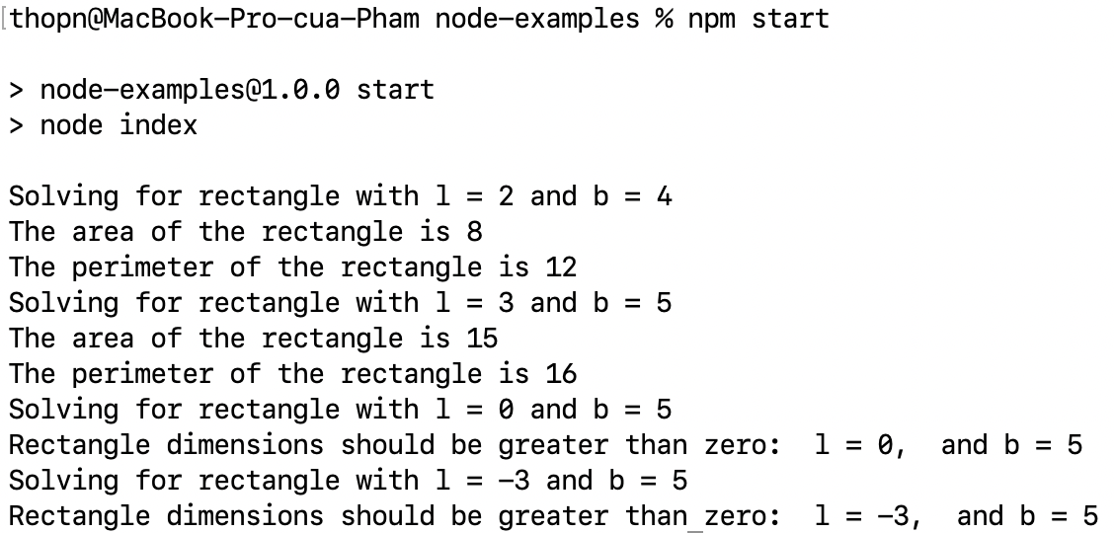
Run Node application
To run the Node application, type the following at the prompt:
npm start

Slide 23
Write a simple Node module

Slide 24
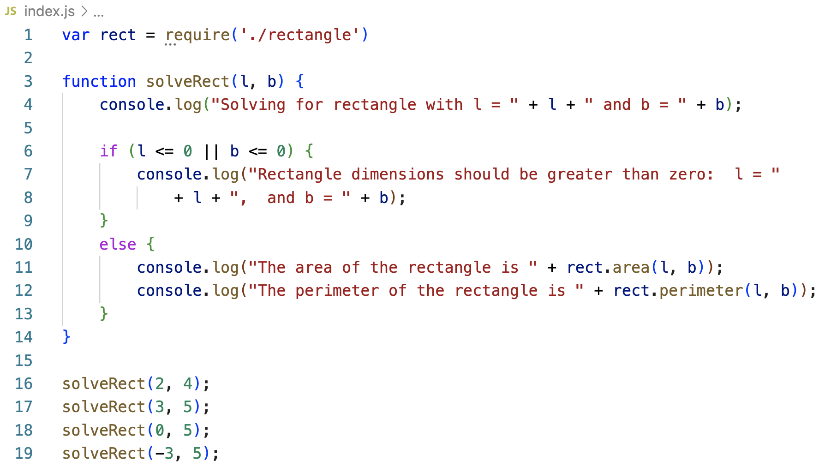
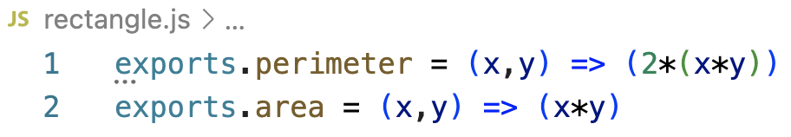
Create a file named rectangle.js
Now, create a file named rectangle.js, and add the following code to it:
Run the Node application like before and observe that the result will be the same.

Slide 25
Using Callback and Error handling in Node applications

Slide 26
Two Salient Features of JavaScript
First-class functions: A function can be treated the same way as any other variable
Closures:
A function defined inside another function has access to all the variables declared in the outer function (outer scope)
He inner function will continue to have access to the variables from the outer scope even after the outer function has returned.

Slide 27
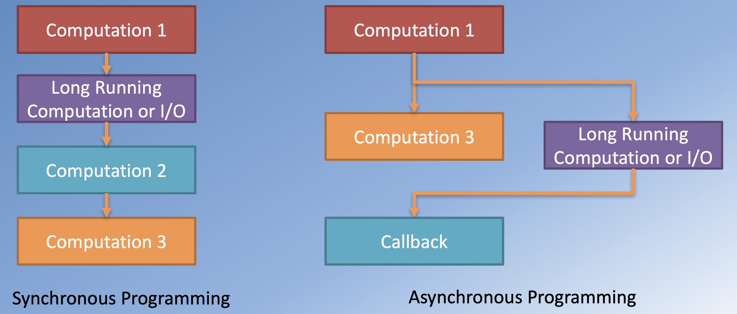
Asynchronous Programming

Slide 28
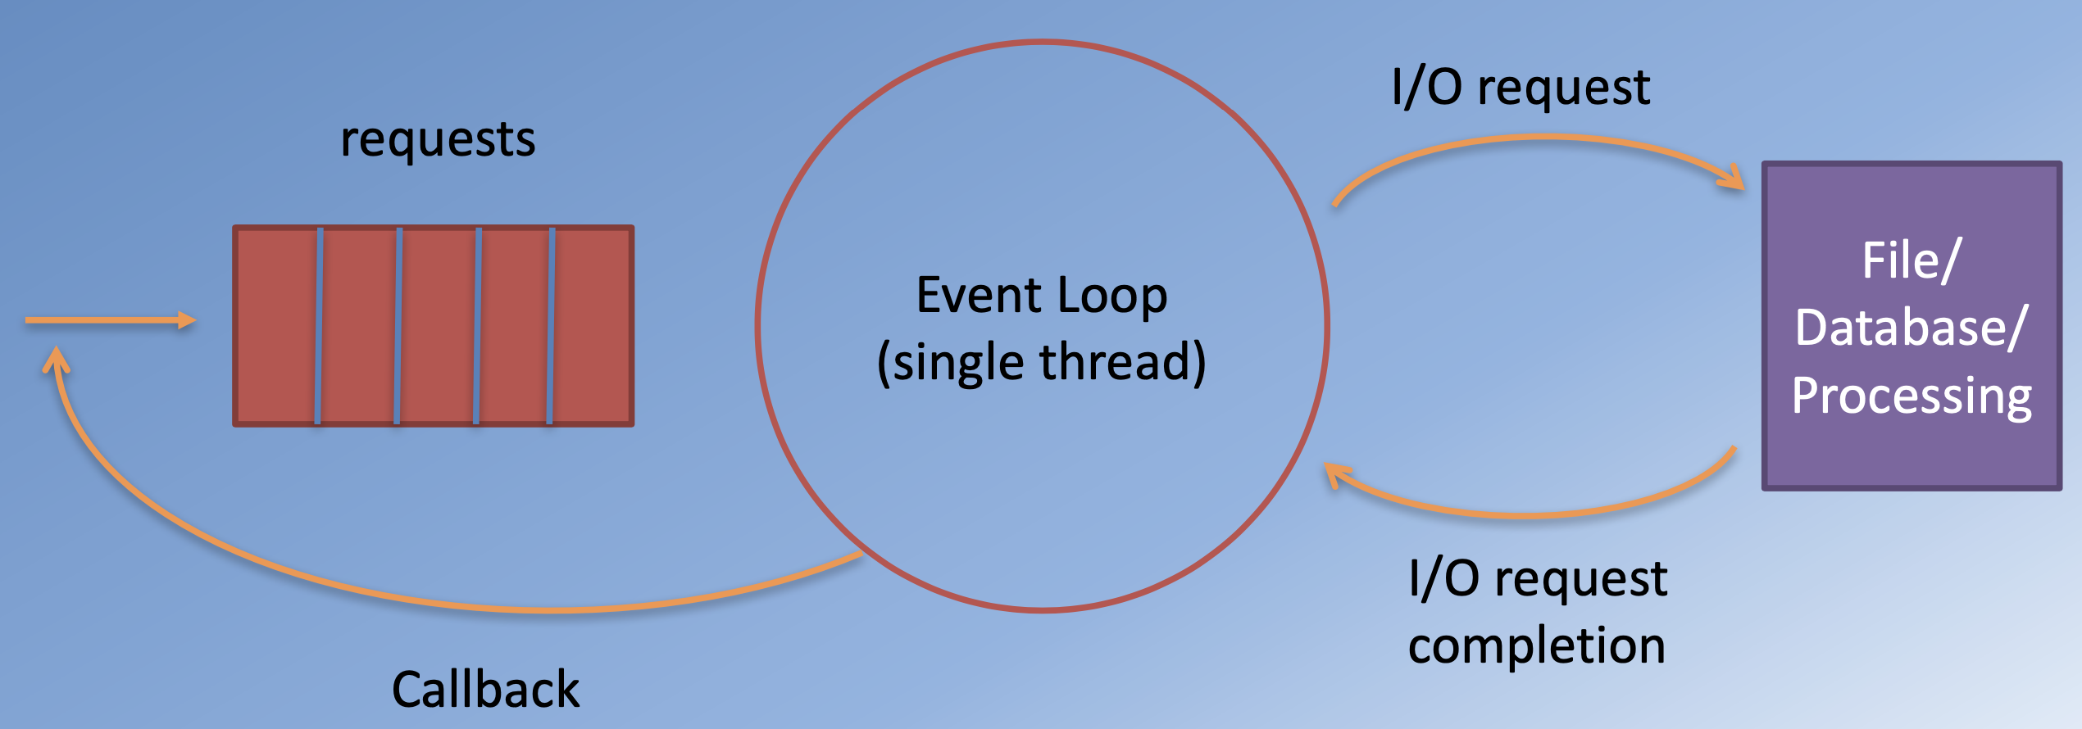
Node, Async I/O and Callbacks

Slide 29
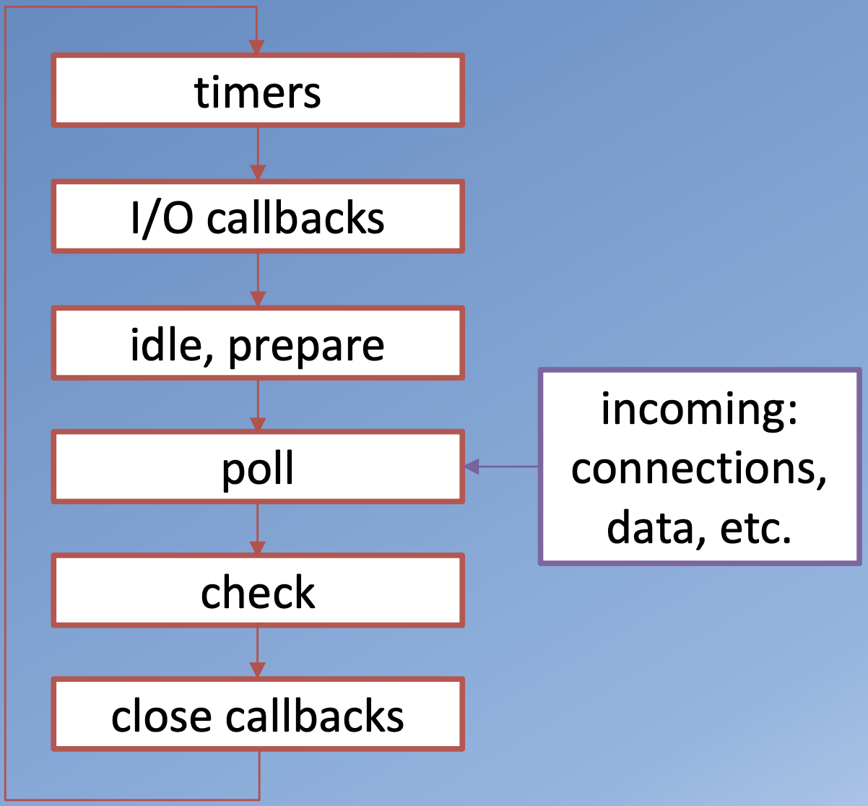
Event Loop
timers: this phase executes callbacks scheduled by setTimeout() and setInterval().
I/O callbacks: executes almost all callbacks with the exception of close callbacks, the ones scheduled by timers, and setImmediate().
idle, prepare: only used internally.
poll: retrieve new I/O events; node
will block here when appropriate.
check: setImmediate() callbacks are
invoked here.
close callbacks:
e.g. socket.on('close', ...).

Slide 30
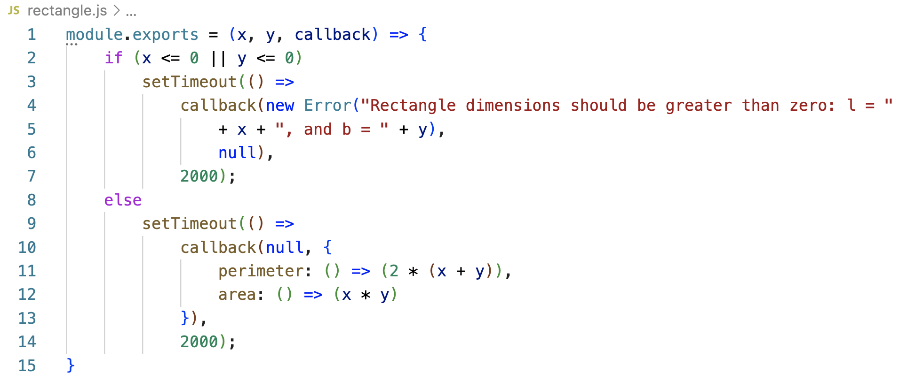
Update rectangle.js file:

Slide 31
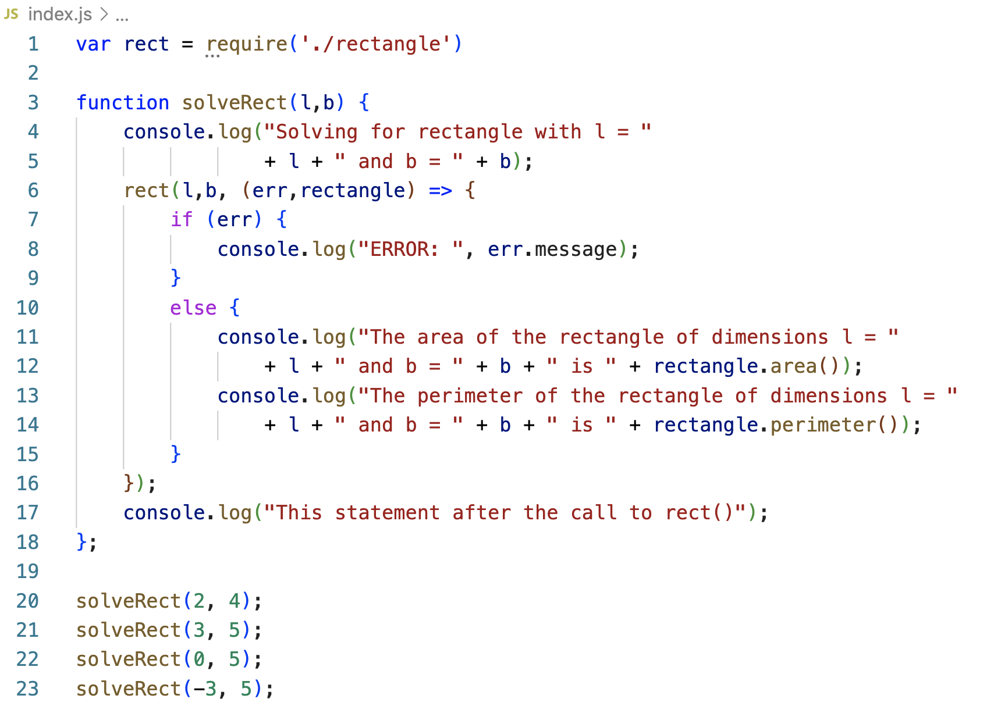
Update index.js file:

Slide 32
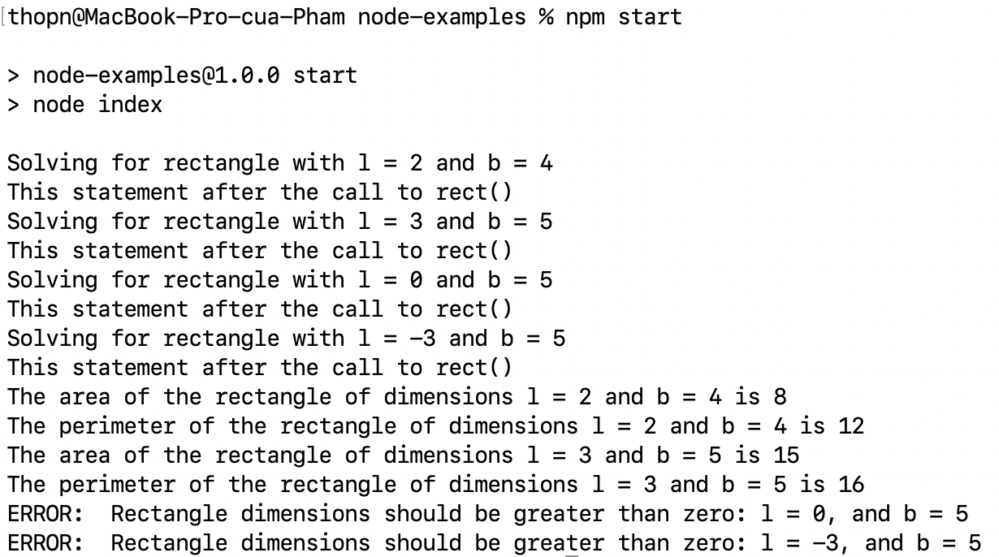
Run the Node application:

Slide 33
Summary
Understand the basics of Node.js
Understand the download and install Node.js and NPM
Write and run a simple Node application in JavaScript
Understand the basics write simple file-based Node modules
Understand the using Callbacks and Error handling in Node applications

